Slide 1

Dagsseminar 16/12-19

Slide 2
Bakgrunn
Labarbeid - prosedyrer
Statistikk - opplæring
Andre oppgaver - standardisering
Notes:
Unngå at gruppemedlemmer finner «sin måte» å gjennomføre en gitt oppgave på -

Slide 3
Standardisering
Best practice i alle faser av et forskningsprosjek
Tidlig involvering og kunnskapsoverføring til nye gruppemedlemmer
Effektiv kompetanseheving og videreføring av kunnskap i forskningsgruppa
Tidsbesparende for alle
Notes:
Mindre «silojobbing»

Slide 4
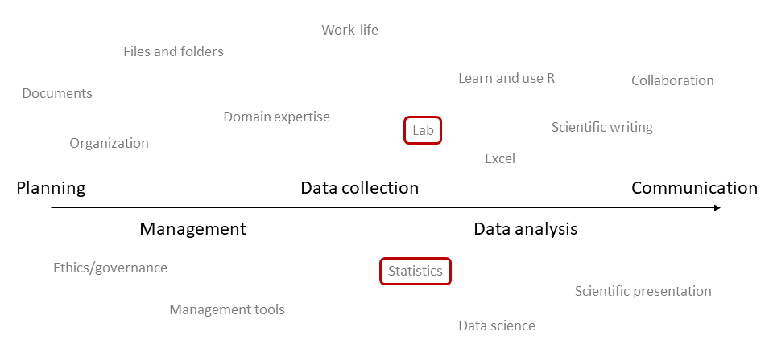

Slide 5
Bruke lipidklasser som eksempel - standardisere
Samle artikler publisert på lipidklasser (Holven/Ulven grp)
Synliggjøre studier «in pipeline» på lipidklasser
Lage standard tekst til artikler:
Metodeavsnitt
Statistikk

Slide 6
Mål for dagen
Innføring: Nightingale-excelfila → forestplots
Hva er et forestplot?
Hva må til for å lage det?
Generelt om data visualisering
Data analyse pipeline
Innføring i R

Slide 7
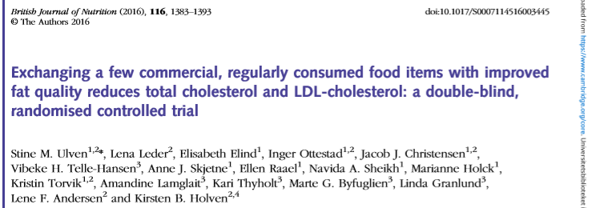
Background: The healthy Nordic diet has shown health beneﬁcial effects among subjects at risk of CVD. However, the extent of food changes needed to
achieve these effects is less explored.
Aim: effects of exchanging commercially available, regularly consumed key food items* with improved fat quality on total cholesterol, LDL-cholesterol and inﬂammatory markers.
Participants: 99 moderately hypercholesterolaemic, non-statin-treated adults (25–70 yrs) completed
Methods: 8 wk double-blinded RCT.
Two arms: experimental diet group (Ex-diet group) and control diet group (C-diet group).
Results: Reduction in tot-C and LDL-C with 9% and 11% (P<0·001), respectively.
*replacing SFA with mostly n-6 PUFA (food items used: e.g. spread on bread, fat for cooking, cheese, bread and cereals)
Notes:
No difference in change in plasma levels of inﬂammatory markers

Slide 8
Karakteristikk
Kjønn
Røyking
BMI
Blodtrykk
Lipider
Glukose, HbA1c
ASAT, ALAT
Kreatinin
CRP
Fettsyrer
Kostdata (kostdagbok)
Compliance (kosthold)

Slide 9
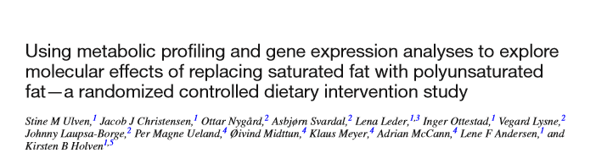
Background: Beyond changes in LDL-C we lack a complete understanding of the physiologic alterations that occur when improving dietary fat quality
Aim: to gain knowledge of metabolic alterations when SFAs were replaced with PUFAs
Methods: We performed comprehensive metabolic profiling with NMR, MS and PBMC gene expression
Results: A large number of lipoprotein subclasses, myristoylcarnitine and palmitoylcarnitine, and kynurenine were reduced, and bile acids, proprotein convertase subtilisin/kexin type 9, acetate, and acetoacetate were increased.
The mRNA levels of LXRA and LDLR were increased, in addition to several liver X receptor α target genes and genes involved in inflammation, whereas the mRNA levels of UCP2 and PPARD were decreased in peripheral blood mononuclear cells after replacing SFAs with PUFAs.
Conclusion: metabolomics in RCT has the potential to extend our knowledge of the effects of dietary fat on CVD risk.
Notes:
No difference in change in plasma levels of inﬂammatory markers

Slide 10
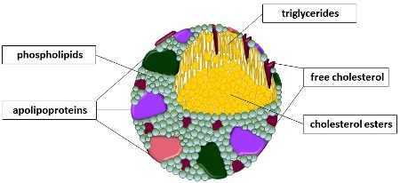
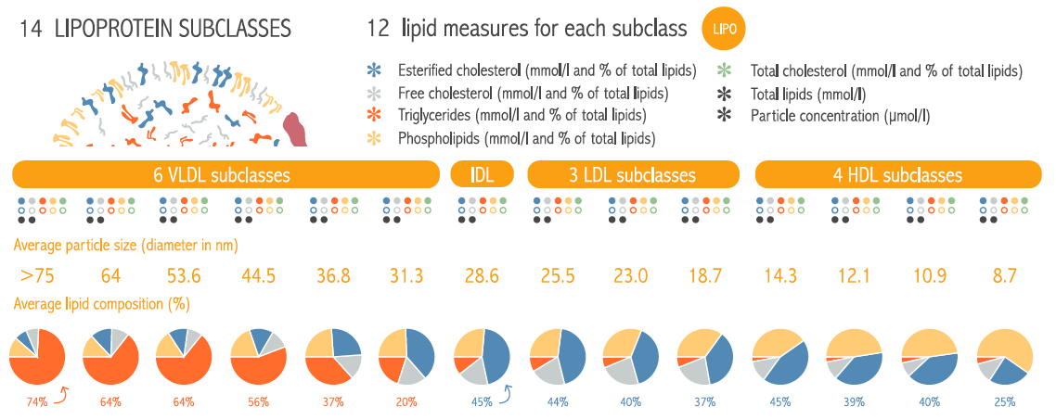
The NMR analyses quantifies lipoprotein subclass particles, and lipids for each subclass
Large Medium Small XL L M S
[Soininen P Circ Cardiovasc Genet 2015/ Christensen JJ 2017]
Notes:
The NMR analyses quantifies lipoprotein subclass particles, as well as lipids for each subclass
1) the conc of 3 LDL subclasses and the lipid composition of the particles
2) The conc of 4 LDL subclasses and the lipid composition of the particles
3) The size of the particles are used to seprate the different subclasses
4) The compostion of the lipoprot particles are also quantified
The lipoprot particles have
Coat of phospholipids
Core of esterified cholesterol

Slide 11



Notes:
Composition (lipids- and apo content)

Slide 12
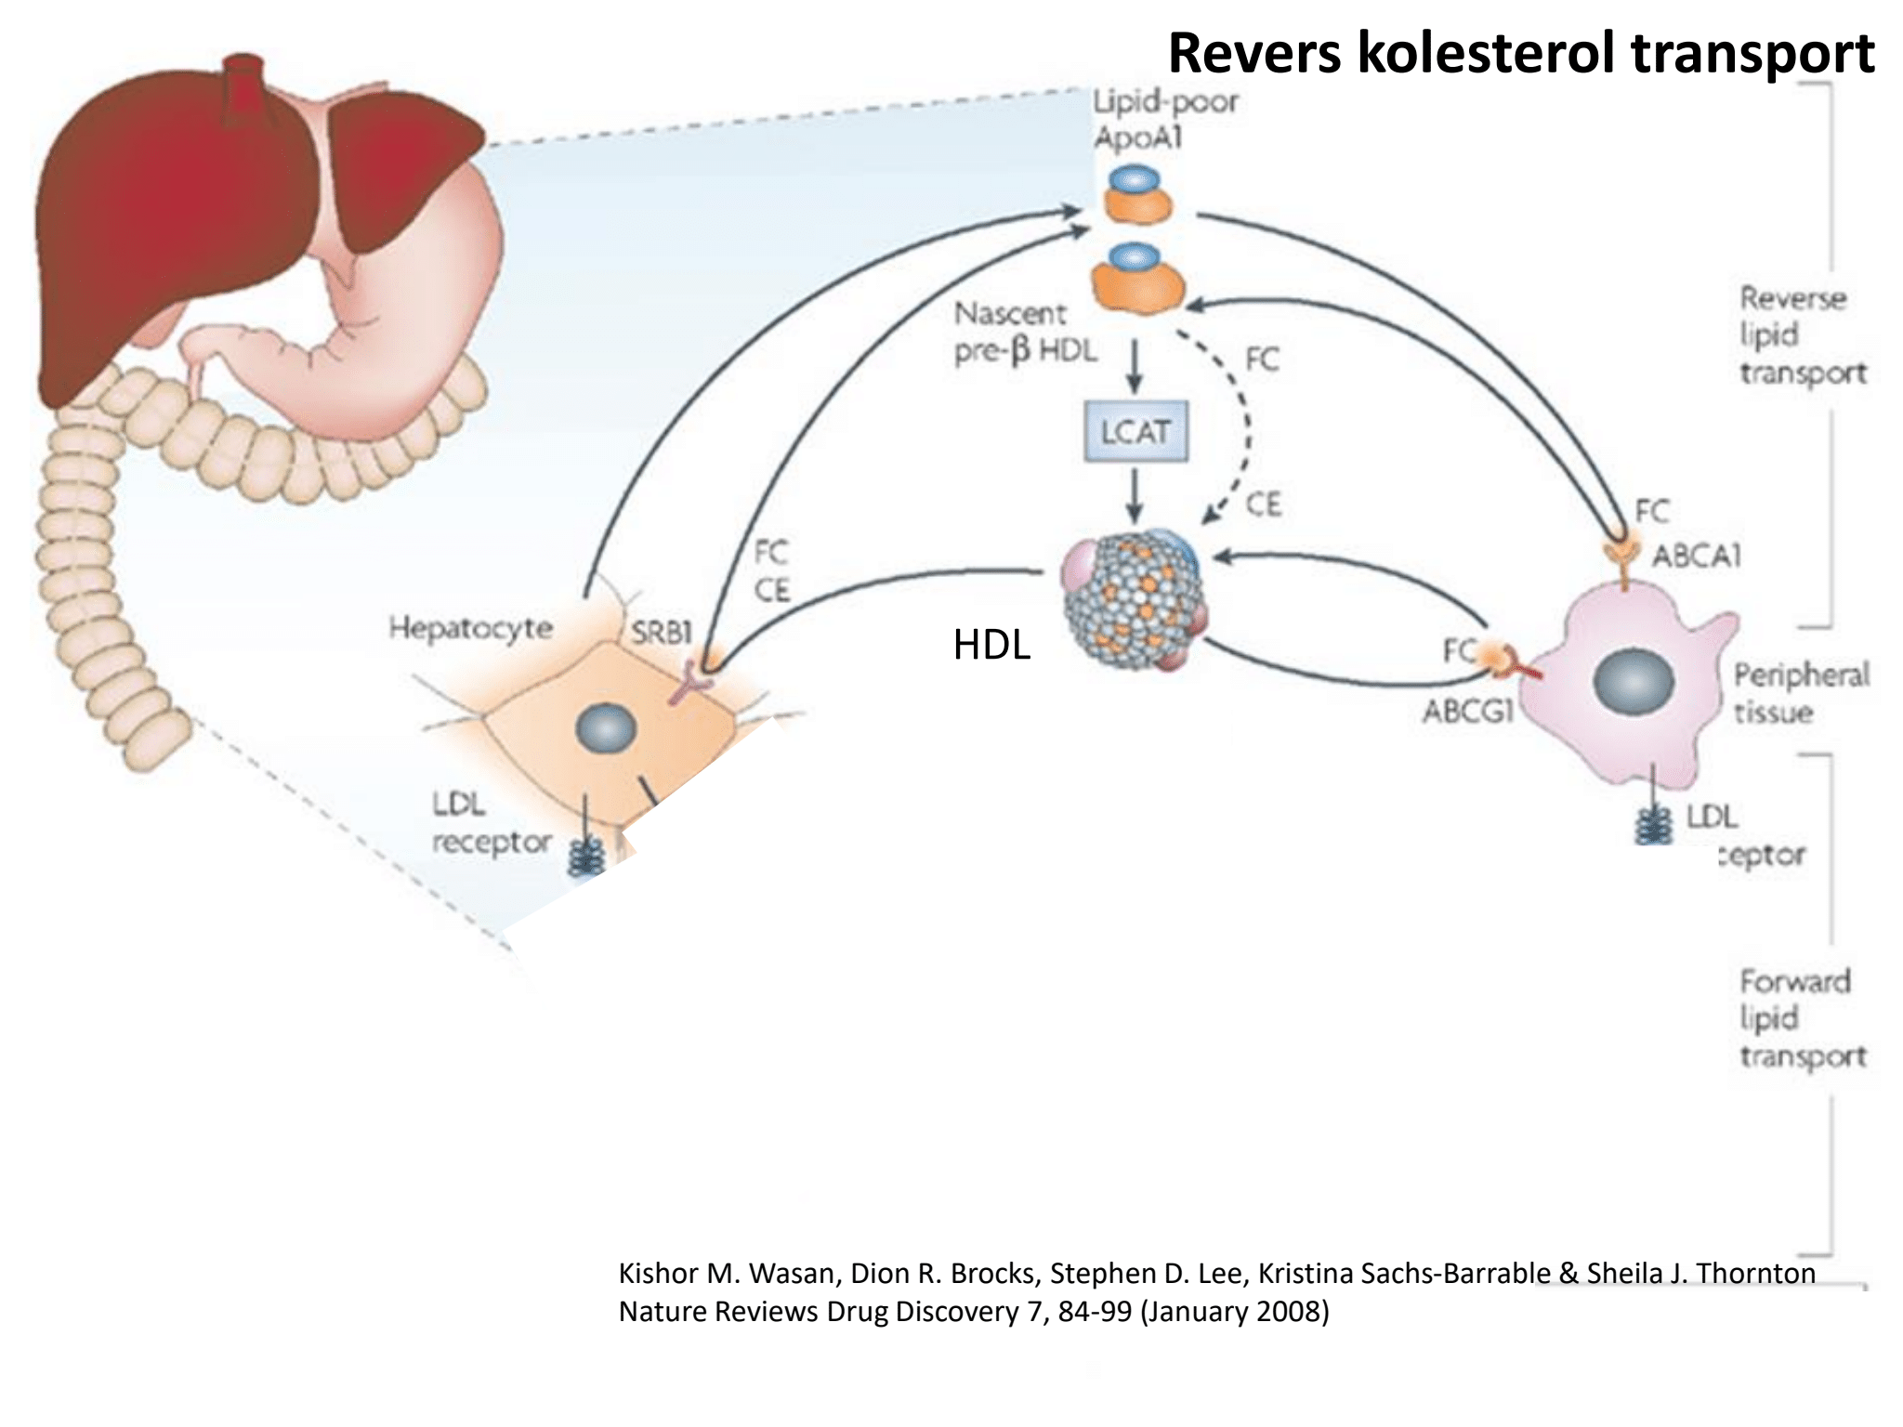
Lipoprotein metabolism
Fig Jacob eller Inger PhD

Slide 13
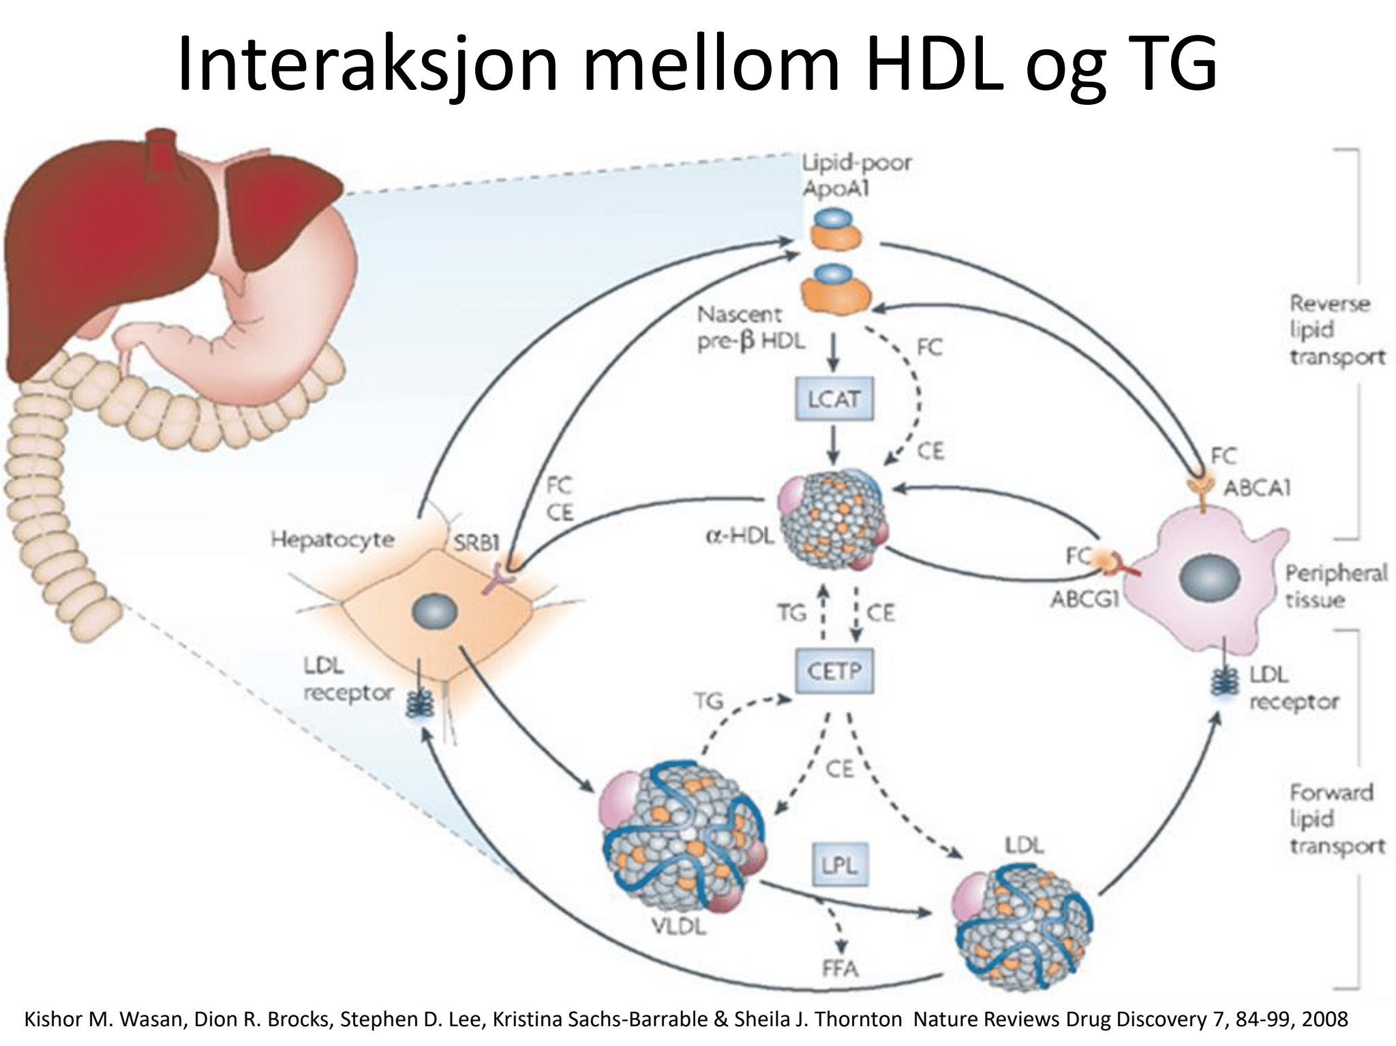

Slide 14
TG
TG
Acetoacetate
Healthy children
TG
Acetate
TG
Peripheral
tissues
TG
LDL
IDL
VLDL
Acetyl-CoA
LDLR
CE
Synth.
CE
CE
Liver
Synth.
LDLR
FA
FC
FC+PL
SR-BI
CETP
CE
ABCA1
ABCG1
S-HDL
(HDL₃)
ABCG5
ABCG8
Bile acids
Cholesterol
TG
M-HDL
L-HDL
XL-HDL
SR-BI
FC+PL
LCAT
Gut
CE
(HDL₂)
Non-statin treated children with
familial hypercholesterolemia
TG
TG
Acetoacetate
TG
Acetate
TG
Peripheral
tissues
TG
LDL
VLDL
Synth.
Acetyl-CoA
LDLR
IDL
CE
CE
CE
FC
Liver
Synth.
SR-BI
LDLR
FA
FC+PL
ABCA1
ABCG1
CETP
CE
ABCG5
ABCG8
S-HDL
(HDL₃)
TG
Bile acids
Cholesterol
M-HDL
L-HDL
XL-HDL
SR-BI
FC+PL
LCAT
Gut
CE
(HDL₂)
[Servier Medical Art]
Notes:
A hypothesis of metabolic events in FH compared with healthy children
Healthy children
Normally, LDL is taken up by both peripheral tissues and the liver (forward cholesterol transport, FCT)
Normally, FC is isterified by LCAT to CE for transport in HDL, and uptake in the liver via SR-BI (reverse cholesterol transport, RCT)
Normally, a considerable part of CE in S-HDL is transferred to VLDL, IDL and LDL via CETP, all of which end up as LDL for hepatic uptake via LDLR (alternative RCT)
This CETP-mediated alternative RCT transport is probably driven by a gradient of CE and TG
Non-statin treated FH children
FH children have reduced LDLR capacity for LDL clearance (~50 % of normal)
This results in congenstion of LDL, IDL and small VLDL in plasma, which contain lots of lipids/cholesterol (including CE)
This inhibits the flux of CE from S-HDL via CETP
This results in accumulation of CE in S-HDL, and TG in LDL
In total: there is a lower flux in the RCT system, particularly the alternative RCT system (S-HDL→CETP→LDL), but also the classical RCT system
Consequently lower plasma levels of M-HDL
LCAT continues to do its job in the S-HDL particles, resulting in lower content of FC and PL
The latter can also result from a low efflux of FC and PL from peripheral tissues (e.g. muscle, adipose tissue, macrophages, atherosclerotic plaques, etc)
High plasma LDL will possibly also compete with XL-HDL for hepatic uptake via SR-BI
Consequently higher plasma levels of XL-HDL
Combined low uptake via SR-BI and LDLR may lead to lower hepatic content of CE and FC, which increases the synthesis of FC from Acetyl-CoA
Acetyl-CoA can be produced from multiple sources, for example acetate
As more Acetyl-CoA is directed towards FC synthesis, there is less production of the «surplus product» acetoacetate
In the liver, fatty acids esterify FC to CE and thereby bind them in plasma
Cholesterol excretion to the gut may theoretically be either increased (perhaps as a result of maximum activity in the final step of RCT) or decreased (as a result of the impaired HDL-RCT)
Utskillelse til tarm kan teoretisk være økt (kanskje som følge av maksimal RCT) eller nedsatt (kanskje som følge av hemmet RCT)

Slide 15
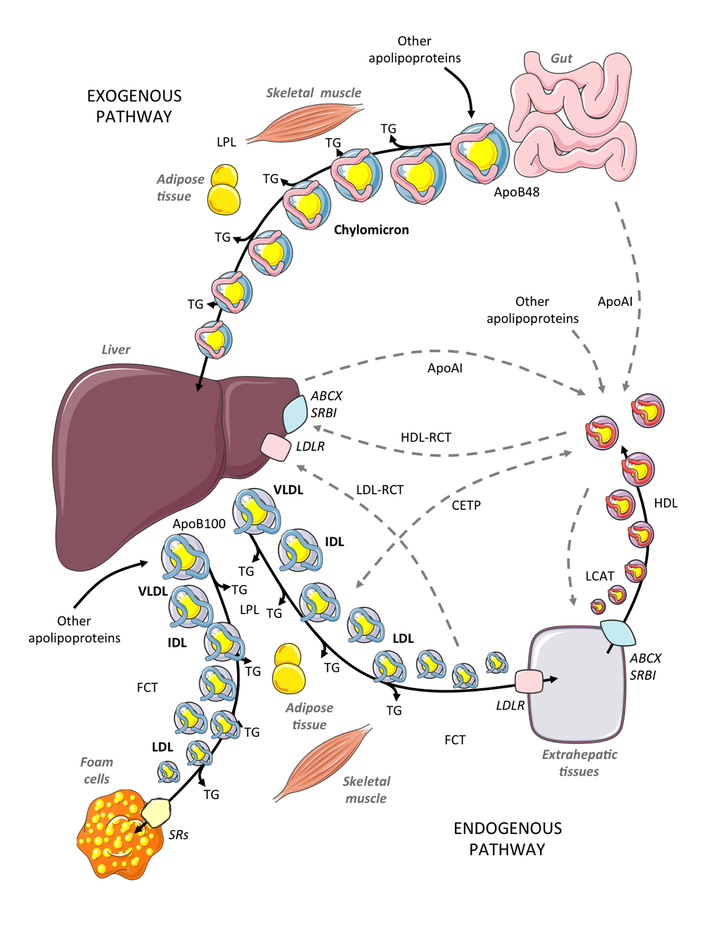
Pleiotropic effects of high LDL-C are less examined in humans
Lipid panel
Total-C
LDL-C
HDL-C
Triglycerides
Lp(a)
ApoB
ApoAI
LDL-C ⬆⬆
[Servier Medical Art]
Notes:
The lipoprotein metabolism is complex
Many organs
Continuum of classes
We measure a small panel to sum it up
What about the rest?
How does high LDL-C affect this whole pattern?

Slide 16
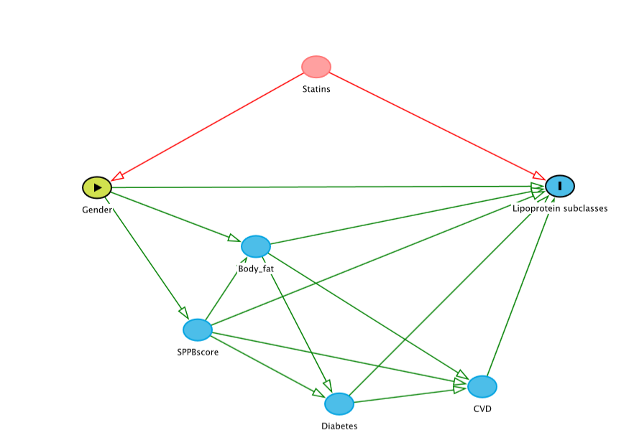
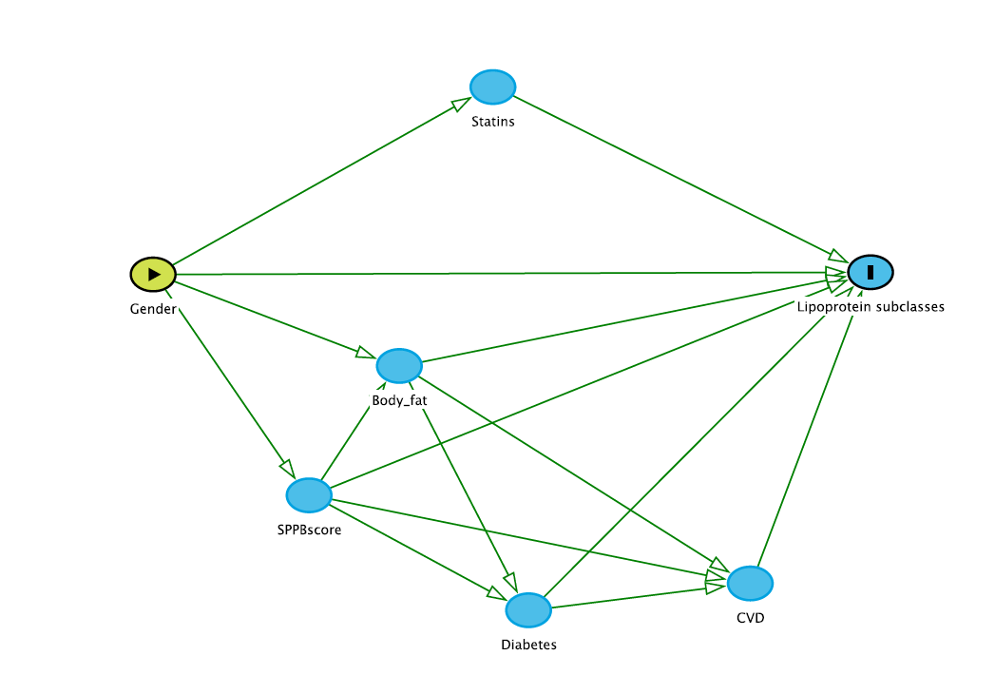
Adjustments for mediators

Slide 17
JAMA artikkel?
Så galt kan det gå

